Slide 1

Transition Year Information Evening
Wednesday October 25th 2017

Slide 2
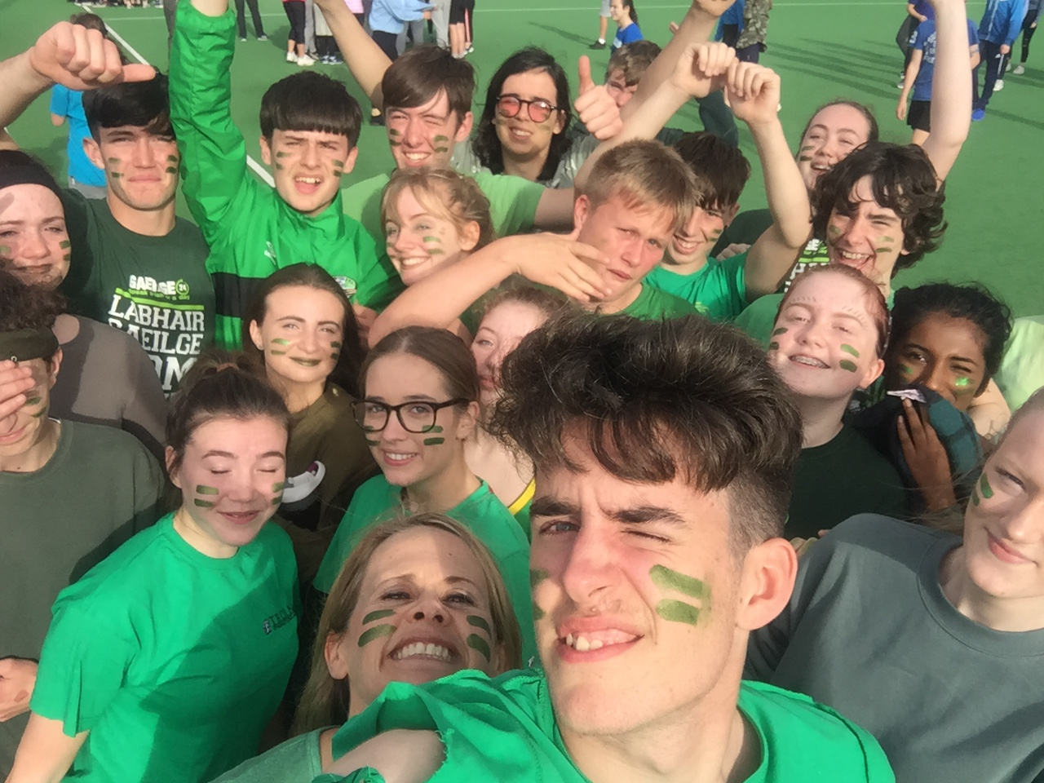
Outline – Why?
To ensure Parents/Guardians were as aware of the structures of TY for those who have never had a student through it before AND to inform those who have about the changes and developments we have made.

Slide 3
Start of the year - 2017
It has been an incredibly busy time of year for all of the students.
Everyone has settled into all of their various activities and different subjects well and should be working hard at this stage.
We have had managed to offer a really wide range of things this year including:
Russian Craft Surfdock
Japanese Film Zumba
Music Catering Theatre and Stage Craft
Art Technical Subjects Mini Company
Business Geography / History Social Studies
Photography Rock Climbing Science

Slide 4
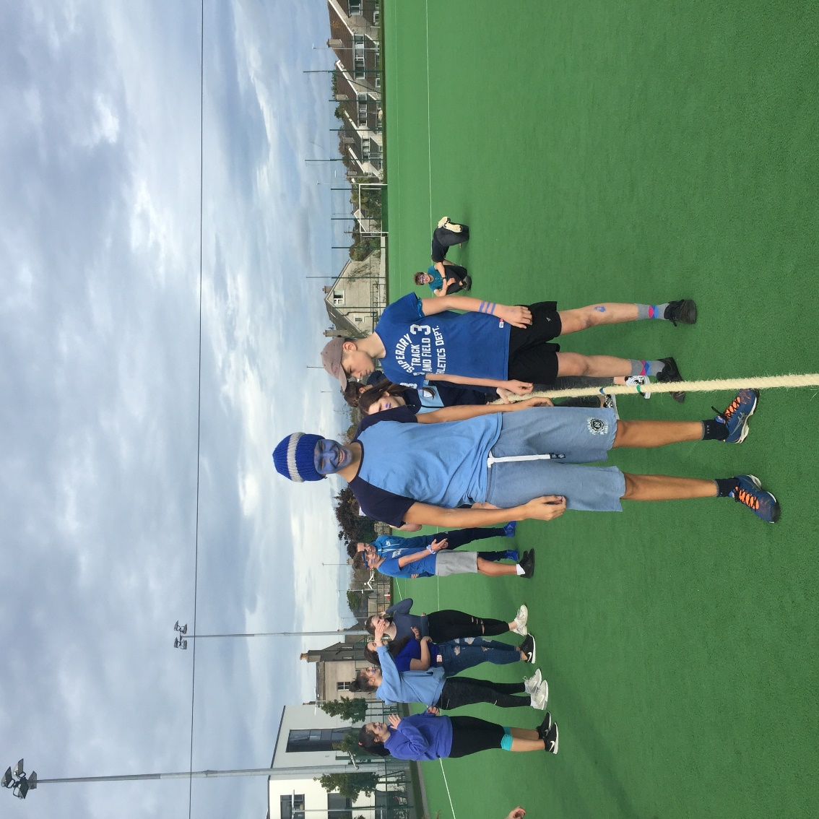
Start of the year - 2017
Attendance has generally been very good.
Must emphasise where a student applies for TY Leave to ensure they can be marked absent with leave on the rolls, the trip must have an educational aspect, e.g. Trinity programmes, extra work experience etc.
We would also point out that we require two weeks notice and that students should not take leave in the final week of the module.

Slide 5
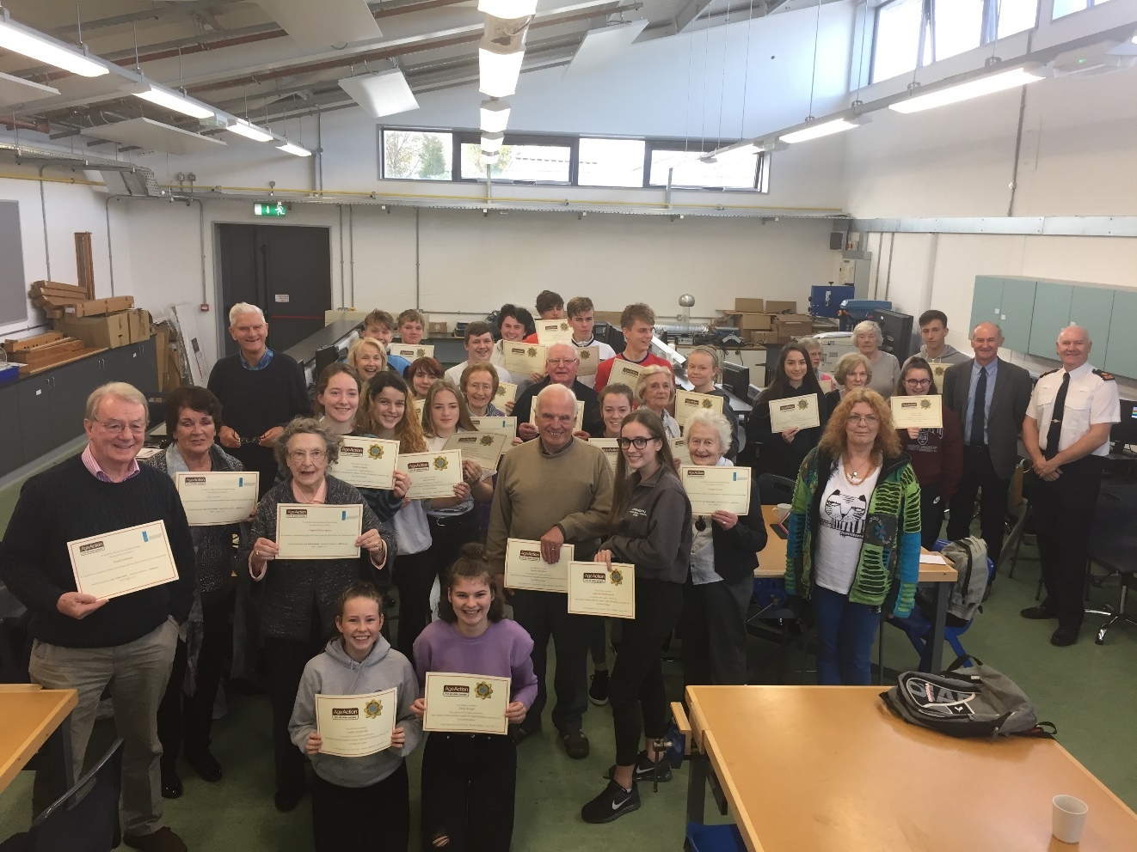
Start of the year - 2017
Special mention to all of those students so heavily involved in all sorts of ECA:
Drama – Macbeth
Hockey – Girls and Boys
Basketball
Rugby – Reaching semi final of league
Techsperts – a real highlight!!

Slide 6
General Information
Can appointments be made outside of regular school time please as it tends to be quite disruptive when students are missing classes. TY timetable allows time especially on Monday afternoons, Tuesday afternoons and Wednesdays for appointments to be made outside of school time.
Parent Teacher Meetings happening:
Friday December 1st
Tuesday December 5th
Please get your student to do some work around their work experience etc. TY is about indeopendence – don’t soak up all of the stress!

Slide 7
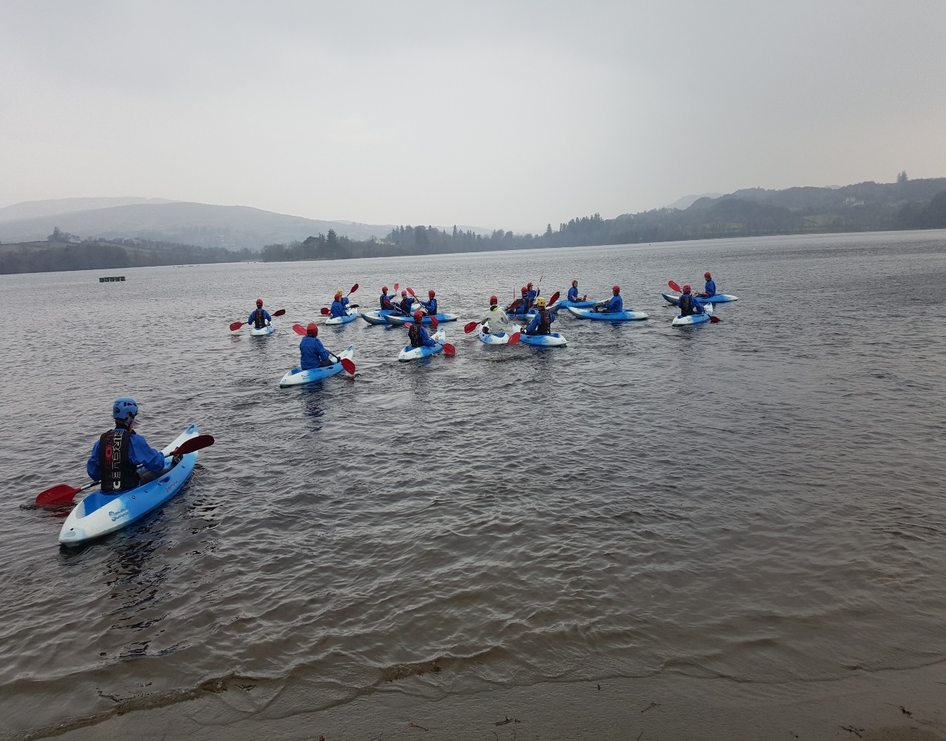
General Information
We would request that anyone in either of the form groups travelling to Gartan OEC in November please ensure they have paid their TY Fee as the bulk goes to pay this invoice.
Ms French (SFR)
Ms Keating (AK)

Slide 8
End of Module Assessment
Total of 450 credits (1350 overall)
Awarded for everything participated in, work completed, in class assessments.
Reports are balanced to reflect evenly; participation, effort, academic ability and enable ALL students of ALL abilities to achieve high grades in TY.
Grades:
60 – 69% = Pass
70 – 85% = Merit
86 – 100% = Distinction

Slide 9
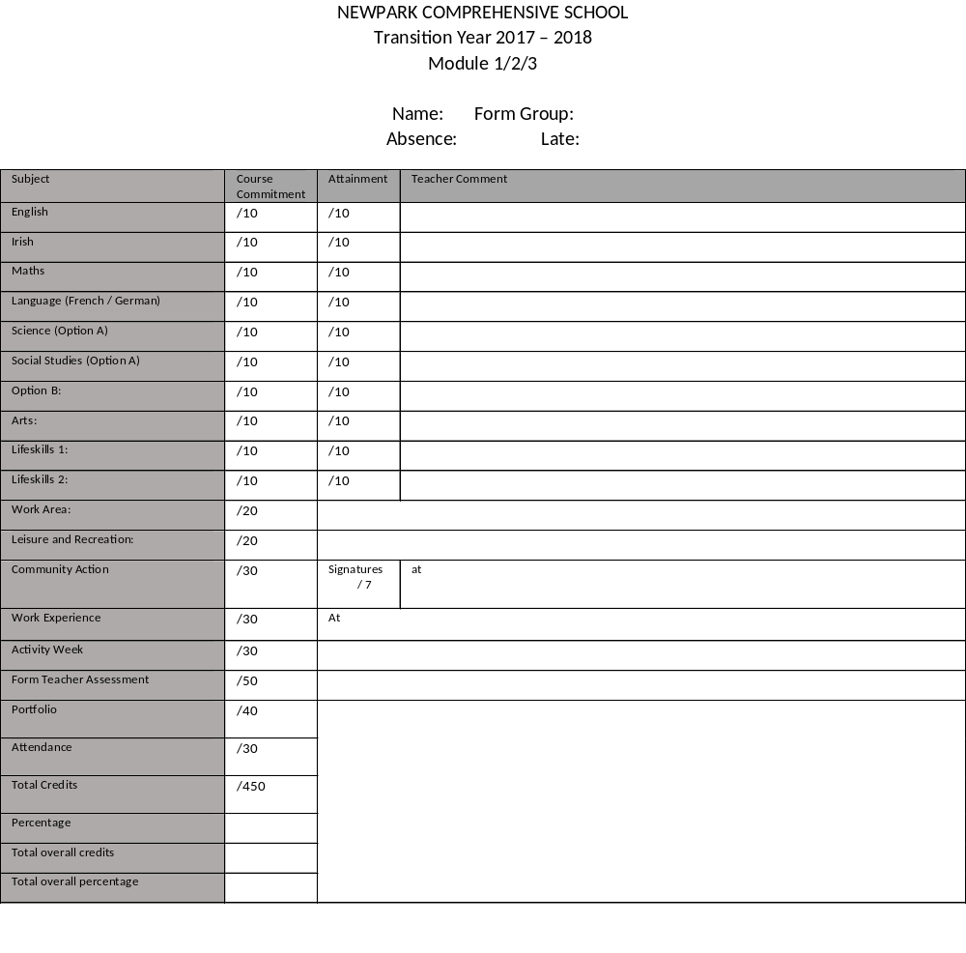
End of Module Assessment – Due to be online before the P-T meetings
Reports (in most cases) will be awarded out of 450
All subjects are /20 (generally 10 for course commitment and 10 for assessment)
Some adjustments may be made for those not doing a subject etc.
3 reports during the year. November, February and May

Slide 10
End of Module Assessment:
2 Types of credits.
Form Teacher Credits:
Community Action 30
Work Experience 30
E-Portflio 40
Attendance / Lates 30
Activity Weeks 30
Extra Credits - 50
ECA
Cooperation
Extras
Other Credits:
Core Subjects
Work Area
Arts
Option
Leisure and Recreation
Science
Social Studies
Lifeskills

Slide 11
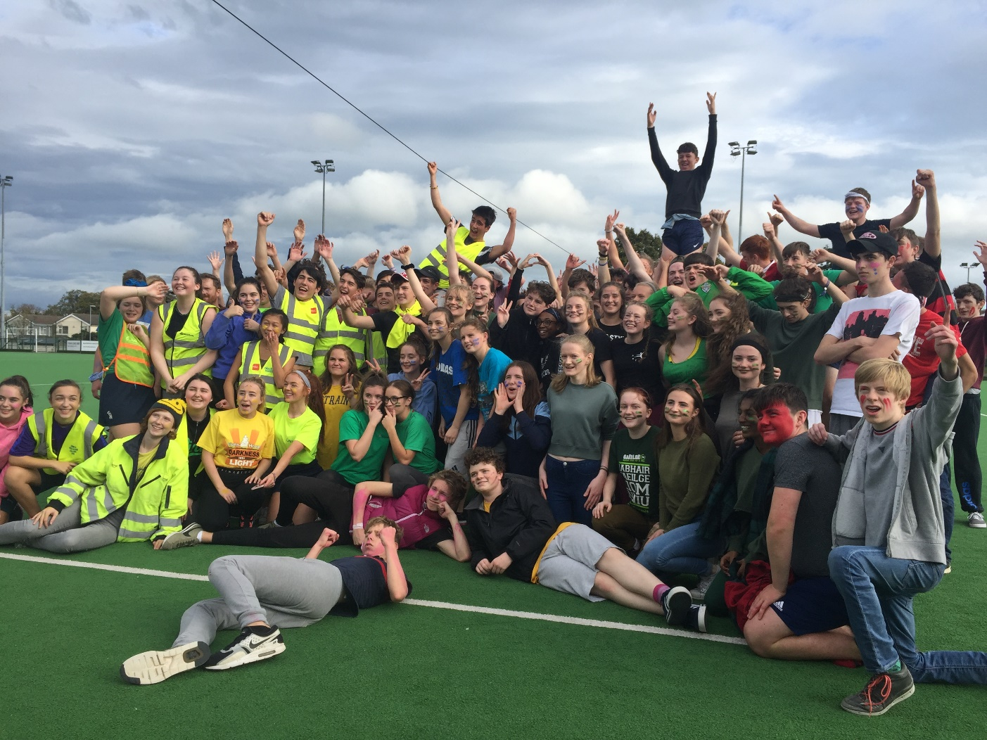
Form Teacher Credits
Folder due in October 25th (TODAY)
To be uploaded to their E-Portfolio by this date.
Work Experience and Activity Week write ups are due the Monday 20th November after activity weeks finish and will be awarded credits after this.
Many of these credits are based on participation and attendance throughout the weeks.
STUDENTS ARE EXPECTED TO BE PRESENT AND ON TIME.

Slide 12
What happens if you fail / pass narrowly?
Support structures:
The Learning support department have in place structures to help students who fail / pass narrowly.
Students will be placed in a support group to help with organisation and folder work.
Maximum of 6 students and they will be chosen by the TY team as to who may benefit most from this support
Missing work:
Students who are missing large amounts of work will be expected to complete it and hand it in
Access to class during Module 2/3 may be restricted until students have completed the missing work. This will be at the discretion of the Year Leader, DP and Principal.

Slide 13
Activity Week Information:
General Information
Punctuality and attendance.
Students are expected to attend on time for all scheduled activities.
Rules are same as if they are in school.
Dress Code
If a student is going to be absent / late for any reason please let the front office know immediately.

Slide 14
Activity Week Information:
Work Experience
Work Experience Forms were due in last Friday October 20th, these should be handed to Form Teachers.
Documentation relating to insurance can be found on the Web Site, , under Student and then Transition Year.
http://www.newparkschool.ie/transition Year
Please dress appropriately for all work experience.
Students must bring their Work Experience Assessment forms and upload their write ups back to their Form Teacher on the first Wednesday after Activity Weeks. (Monday November 20th)

Slide 15
Activity Week Information:
Arts Week
Arts Week activities happen in school. The students have been given a the information in their OneNote all the times and venue. This info is available on the App.
This year again we are theming our Arts week to give it cohesion and everything produced will be on display on TY Graduation at the end of the year.
Please be punctual and attend EVERY day otherwise you and your group will miss out.

Slide 16
Activity Week Information:
In Dublin Week
In Dublin Week has a variety of exciting activities this year.
Students MUST note different times, meeting places and locations. This will be given out next week and the information will be on the App and they have it in OneNote.
Please dress appropriately where it is necessary, e.g. the Courts, Leinster House, this is important as we do not a have a uniform.
It is imperative that all TY students have a Leap Card as they will be travelling around the city on LUAS, DART and Bus. It saves time and money.
If a student is late please let the school know IMMEDIATELY so that groups are not waiting for someone who is not coming / can make arrangements to wait for someone.

Slide 17
Activity Week Information:
Outdoor Pursuits – Gartan OEC
Bus departs from school at 7:30am on Monday morning.
Returns to Parnell Square at 3:30pm approx. on Friday.
Form Teachers will have filled in dietary, medical and other requirements and sent through booking forms.
Students will be given a list of what to bring in the coming week.
There is NO need for students to have large amounts of cash with them, spending access will be very restricted.
If someone is not going to travel due to illness etc please send an email to myself and the students Form Teacher ASAP.

Slide 18
Activity Week Information:
Outdoor Pursuits – Gartan OEC.
Rules are set in place as per Newpark’s Trips Policy which can be found at http://www.newparkschool.ie/policiesprocedures
PLEASE REMIND AND GO THROUGH WITH THE STUDENTS THE CONSENT FORM SIGNED IN THEIR BOOKLETS AT THE START OF THE YEAR
As set out in the rules, no misuse of any substances will be tolerated and consequences will ensue.
Discipline is in the hands of the Centre staff and the Newpark staff.
While away all students are expected to show respect in all interactions they have with other students, staff and other adults.

Slide 19
Thank you for
coming in tonight!!

