Slide 1

Transition Year Information Evening
Wednesday October 19th 2016

Slide 2
Start of the year - 2016
It has been an incredibly busy time of year for all of the students.
Everyone has settled into all of their various activities and different sucjects well and should be working hard at this stage.
We have had managed to offer a really wide range of things this year including:
Russian Craft Surfdock
Chinese Film Girls Rugby
Music Catering Theatre and Stage Craft
Art Technical Subjects Mini Company
Business Geography / History Social Studies
Photography Rock Climbing Science
And managed to squeeze some IT in for the students on a Friday afternoon for the first time to help them with their E-Portfolios.

Slide 3
Start of the year - 2016
Many students have been involved in a wide number of exciting trips within school and outside of school:
Fighting Words Creative Writing
Art Trips
Axa Roadsafe Roadshow
Work Experience with the Garda
New York for Boxing
Dun Laoghaire for Sailing
South Africa for Charity work
Austria to learn German
Must emphasise where a student applies for TY Leave to ensure they can be marked absent with leave on the rolls, the trip must have an educational aspect.

Slide 4
General Information
Can appointments be made outside of regular school time please as it tends to be quite disruptive when students are missing classes. TY timetable allows time especially on Mondays, Tuesdays and Wednesdays for appointments to be made outside of school time.
Parent Teacher Meetings happening in late November / early December after reports for Module 1 go home.

Slide 5
General Information
We would request that anyone in either of the form groups travelling to Gartan OEC in November please ensure they have paid their TY Fee as the bulk goes to pay this invoice.
Ms French (SFR)
Ms Keating (AK)

Slide 6
Garda Vetting
New legislation put in place from May this year.
Lack of clarity around requirements for those aged 16-18
http://www.newparkschool.ie/wp-content/uploads/2016/09/eVetting-for-TY-Students-September-2016.pdf
Apologies for any confusion to date but it has been a learning process for ourselves, the vetting bureau and everyone involved.
Current Procedure:
Vetting forms NB1 and NB3 (Parental Consent) filled in and sent directly to Derek Lowry c/o School office:
Sent on school management body
who send online form to be completed by the applicant.
Then sent to Vetting Bureau
Returned to management body and then to school
The procedure appears to be taking between 10-21 days currently.

Slide 7
End of Module Assessment
Total of 325 credits (1000 overall)
Awarded for everything participated in, work completed, in class assessments.
Reports are balanced to reflect evenly; participation, effort, academic ability and enable ALL students of ALL abilities to achieve high grades in TY.
Grades:
60 – 69% = Pass
70 – 85% = Merit
86 – 100% = Distinction

Slide 8
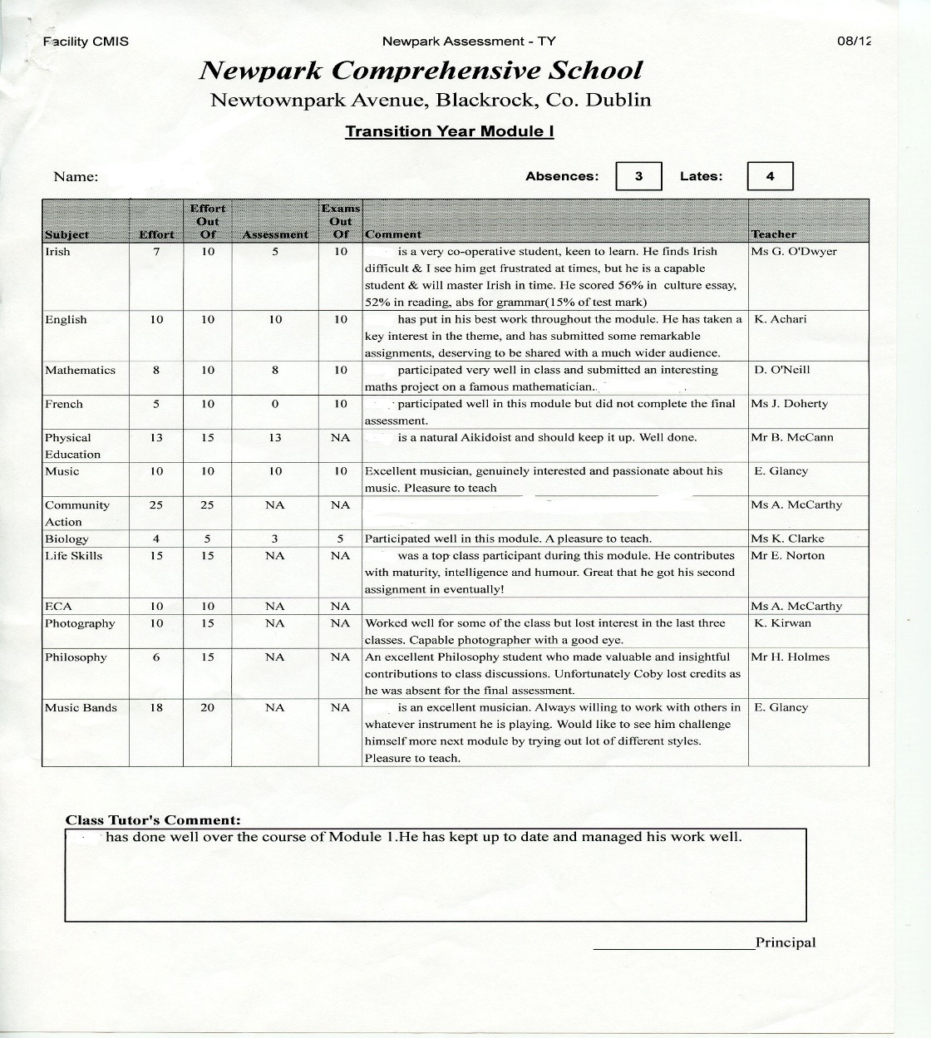
End of Module Assessment
Reports (in most cases) will be awarded out of 325
Some adjustments may be made for those not doing a subject etc.
3 reports during the year. November, February and May

Slide 9
End of Module Assessment:
2 Types of credits.
Form Teacher Credits:
Discussion
Work Experience
Folder
ECA
Community Action
Activity Weeks
Attendance / Lates
Other Credits:
Core Subjects
Work Area
Arts
Option
Leisure and Recreation
Science
Social Studies
Lifeskills

Slide 10
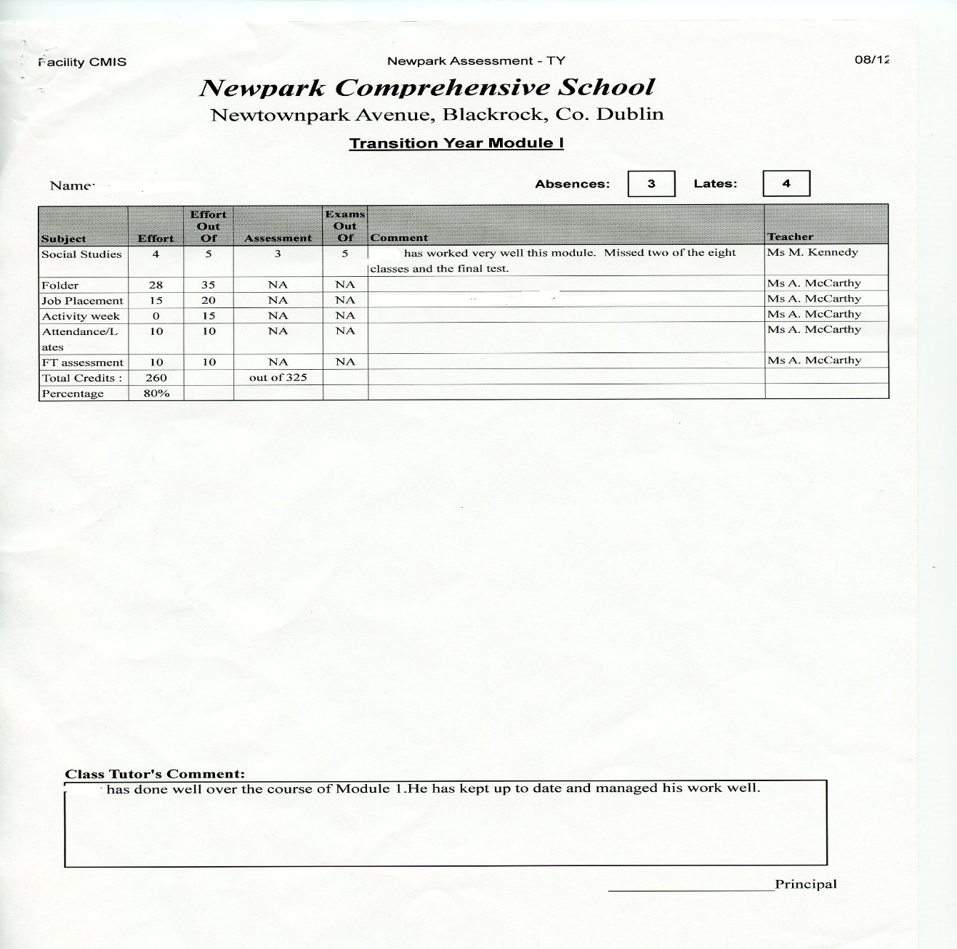
Form Teacher Credits
Folder due in October 26th
To be uploaded to their E-Portfolio by this date.
Work Experience and Activity Week write ups are due the Wednesday 23rd November after activity weeks finish and will be awarded credits after this.
Many of these credits are based on participation and attendance throughout the weeks. STUDENTS ARE EXPECTED TO BE PRESENT AND ON TIME.

Slide 11
What happens if you fail / pass narrowly?
Support structures:
The Learning support department have in place structures to help students who fail / pass narrowly.
Students will be placed in a support group to help with organisation and folder work.
Maximum of 6 students and they will be chosen by the TY team as to who may benefit most from this support
Missing work:
Students who are missing large amounts of work will be expected to complete it and hand it in
Access to class during Module 2/3 may be restricted until students have completed the missing work. This will be at the discretion of the Year Leader, DP and Principal.

Slide 12
Activity Week Information:
General Information
Punctuality and attendance.
Students are expected to attend on time for all scheduled activities.
Rules are same as if they are in school.
There are some dress code regulations so please make yourself aware of these.
If a student is going to be absent / late for any reason please let the front office know immediately.

Slide 13
Activity Week Information:
Work Experience
Work Experience Forms were due in last Wednesday October 12th, these should be handed to Form Teachers.
Documentation relating to insurance can be found on the Web Site, , under Student and then Transition Year.
http://www.newparkschool.ie/transition Year
Please dress appropriately for all work experience.
Students must bring their Work Experience Assessment forms and upload their write ups back to their Form Teacher on the first Wednesday after Activity Weeks. (Wednesday November 23rd)

Slide 14
Activity Week Information:
Arts Week
Arts Week activities happen mostly in school. The students will be given a sheet with times and venues next week. This info will also be on the App.
This year we are theming our Arts week to give it cohesion and everything produced will be on display on TY Graduation at the end of the year.
Please be punctual and attend EVERY day otherwise you will miss out.

Slide 15
Activity Week Information:
In Dublin Week
In Dublin Week has a variety of exciting activities this year.
Students MUST note different times, meeting places and locations. This will be given out next week and the information will be on the App.
Please dress appropriately where it is necessary, e.g. the Courts, Leinster House, this is important as we do not a have a uniform.
It is imperative that all TY students have a Leap Card as they will be travelling around the city on LUAS, DART and Bus. It saves time and money.
If a student is late please let the school know IMMEDIATELY so that groups are not waiting for someone who is not coming / can make arrangements to wait for someone.

Slide 16
Activity Week Information:
Outdoor Pursuits – Gartan OEC
Bus departs from school at 7:30am on Monday morning.
Returns to Parnell Square at 3:30pm approx. on Friday.
Form Teachers will have filled in dietary, medical and other requirements and sent through booking forms.
Students will be given a list of what to bring in the coming week.
There is NO need for students to have large amounts of cash with them, spending access will be very restricted.
If someone is not going to travel due to illness etc please send an email to myself and the students Form Teacher ASAP.

Slide 17
Activity Week Information:
Outdoor Pursuits – Gartan OEC.
Rules are set in place as per Newpark’s Trips Policy which can be found at http://www.newparkschool.ie/policiesprocedures
PLEASE REMIND THE STUDENTS OF THE CONSENT FORM SIGNED IN THEIR BOOKLETS AT THE START OF THE YEAR
As set out in the rules, no misuse of any substances will be tolerated and consequences will ensue.
Discipline is in the hands of the Centre staff and the Newpark staff.
While away all students are expected to show respect in all interactions they have with other students, staff and other adults.

Slide 18
Thank you for
coming in tonight!!

