Slide 1

Information Meeting
WELCOME!
9th November 2017

Slide 2
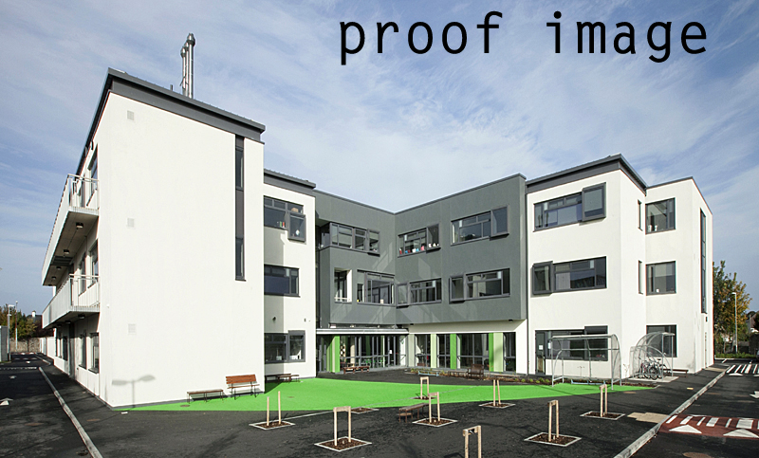

Slide 3

The Questions to Ask
A. What do you want for your children at school?
B. What are your educational priorities for your children?

Slide 4
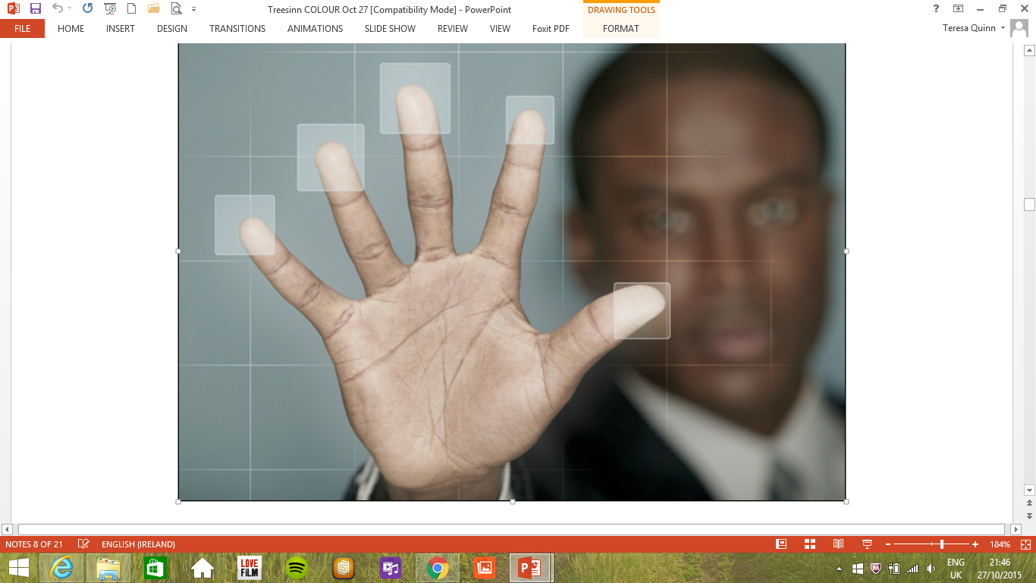
Choice
Diversity
Respect
Inclusivity
Creativity
What characterises Newpark

Slide 5


Different Approach
Improving the Curriculum and Learning Experience
Notes:
New Framework was published on August 25th 2015

Slide 6

www.juniorcycle.ie
Priority Learning Units
Subjects
Well-Being
Short Courses
Other Learning Experiences
8 Key Skills
24 Statements of Learning
8 Principles
Notes:
Basically it starts with 8 Principles which will inform the planning

Slide 7



8
Key Skills
Notes:
LISTED HERE ARE 6 of the Key Skills, with Literacy & Numeray becomes 8
Creating ideas
Being active
Working with others
Imagining possible solutions
Showing initiative
Self-evaluating
Taking responsibility
Questioning things

Slide 8
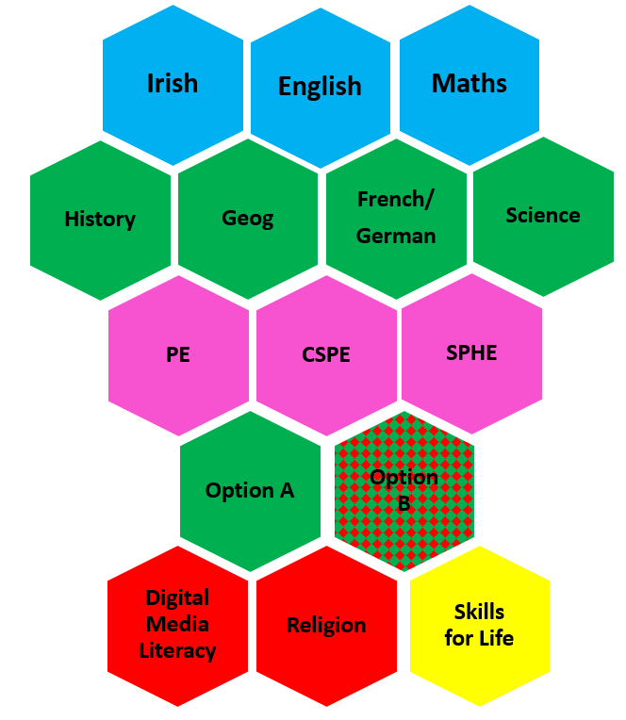

Current JC Programme in Newpark
for 1st Year cohort starting 2017

Slide 9
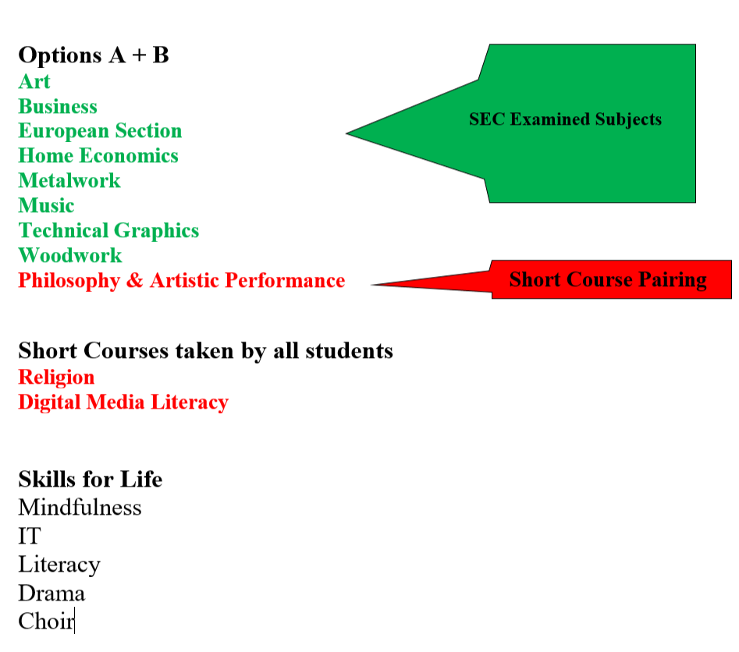
The JC programme in Newpark will continue to evolve over the next few years. We are currently looking at the feasibility of introducing some of the following Short Courses:
Coding
Film Studies
Visual Design
Technology
Short Course versions of existing SEC examined subjects

Slide 10





JUNIORCYCLEPROFILEOFACHIEVEMENT
2017
John Kelly
DOB:
21 June 2001
STATECERTIFIED FINALEXAMINATIONS
Classroom-BasedAssessments- English
Examinationnumber:
456985
English(O)
Distinction
OralCommunication
Above expectations
Collection of Texts
In line with expectations
Irish (O) ⁽²⁾
A
Classroom-BasedAssessments- Short Courses
Mathematics(H)
B
Coding
In line with expectations
History (H)
C
PhysicalEducation
Above expectations
Geography(H)
D
ArtisticPerformance
Exceptional
French (O) ⁽²⁾
C
Philosophy
In line with expectations
BusinessStudies(H)
B
Science (H)
B
C.S.P.E.(C)
A
Other Areasof Learning ?
The school has flexibility to report on other learning experiences/events that the student has participated in outside the formal timetabled curriculum such as;
Engagement with co-curricular or extra-curricular activities such as a science fair, school's sporting activities or debating.
Specific learning opportunities that do not form part of subjects or short courses, i.e; leadership training; activities relating to guidance; membership of school clubs or societies; membership of school's student council.
Engagements that form part of the formal timetabled curriculum but not reported on in other sections of the JCPA i.e; engagement with a school's own religious education programme or with elements of the PE, SPHE curriculum and CSPE.
Principal
Year Head
Roll Number: 60090Q
Anytown SecondarySchool Anytown,Co.Anytown V94HXW5
Ms MaryRyan
MR.Jack Quigley
ThisJCPA recognises and records achievements in Junior Cycle.

Slide 11

Expectations
Every student is encouraged to reach her/his potential

Slide 13
National average in HE participation is 60% in Ireland and 40% in UK.
80% of our HE students attend UCD, DIT, TCD or IADT.
Newpark’s ‘first destination’ statistics reflect appropriate next step education and training choices (i.e. according to learning style) and informed career decision making on behalf our students.

Slide 14
English, Irish and Maths
English- Very high % attempting HL 94% -National Average 78%
Increasing numbers in HL Maths and Irish in Junior Cycle
Trend continuing through into LC especially in Maths.
Notes:
This talk is available on the following link:
http://newparkschool.ie/day-to-day/junior-cycle/
Other relevant Junior Cycle documents

Slide 15
The Comprehensive Curriculum
Junior Cycle Profile of Achievement
Transition Year
Leaving Certificate
Established Leaving Certificate (ELC)
Leaving Certificate Vocational Programme (LCVP)
Leaving Certificate Applied (LCA)

Slide 16
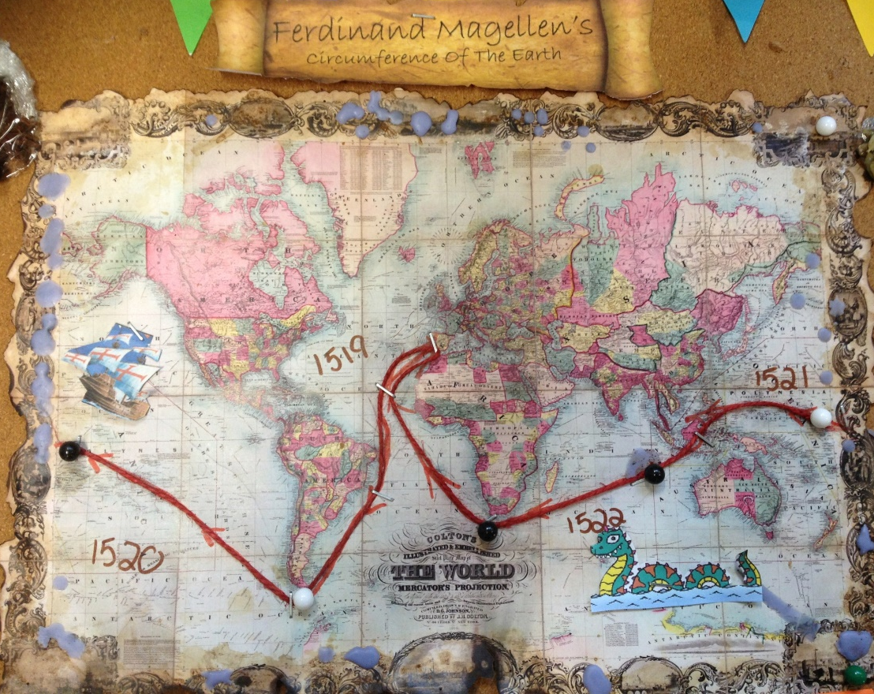
Years 1-3
The Comprehensive Curriculum
Core Subjects
English, Irish, Mathematics,
Physical Education and Religious Education
Civic Social & Political Education
Social Personal & Health Education
Humanities
History and Geography
Languages
French
German
European Section

Slide 17
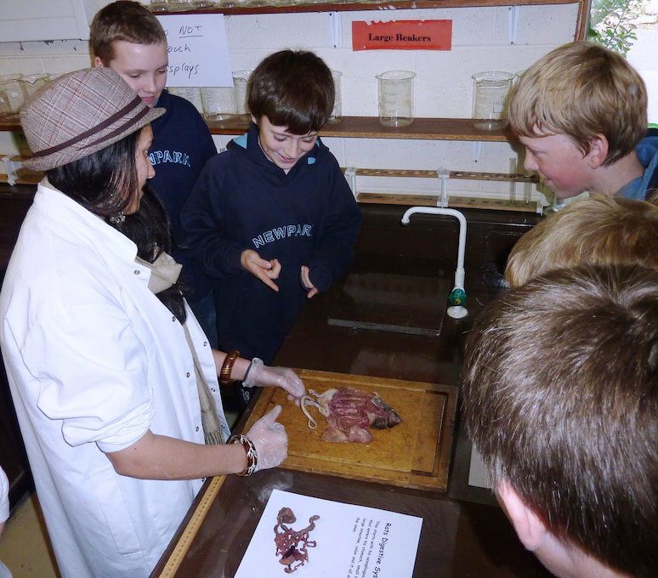
Years 1-3
The Comprehensive Curriculum
Arts
Music, Drama, Art
Science
General course, including Physics, Chemistry, Biology
Modular Course
Computers

Slide 18
WELLBEING – PE, SPHE and CSPE
The Comprehensive Curriculum
Physical Education
Modular programme
1-2 sessions per week
Dance, Swimming, Hockey
Basketball, Soccer, Rugby
Volleyball, Orienteering
Cross-Country, Athletics, Gymnastics
Social, Personal and Health Education
Civic, Social and Political Education

Slide 19

The European Section
Unique aspects of Provision
Newpark, DES and the French Government
French language and Civilisation
Capacity and Potential
Raises European and International Awareness
French Exchange
Opportunities for studies abroad
Notes:
Co-operative project: Newpark, DES and the French Government
Intensive course of French language and civilisation
For students who have shown a capacity and potential
Raises European and international awareness
Constitutes one of the Options
Active and material support of parents is essential
Essential for students to spend time in France
Raises opportunities for the pursuit of studies abroad

Slide 20


Schlinks Music Programme
Unique aspects of Provision
Instrumental lessons
given by qualified
Music Teachers at
Newpark Music Centre
Notes:
Junior Certificate Subject
Range of Musical Activities
SchoolLinks with Newpark Music Centre
Instrumental lessons – choice of instruments
Tuition by Qualified Music Centre staff
Twenty six-week term (30-minute lessons)
Special fee-rate for Newpark Students

Slide 21
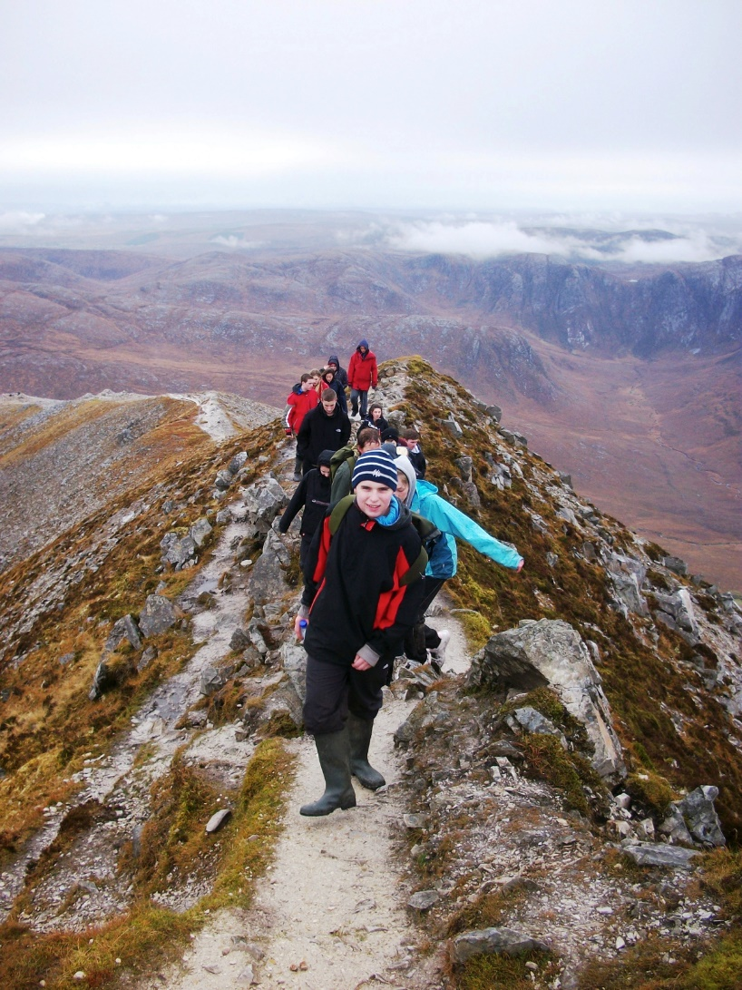
Giving Values a Reality
Varied curriculum
Compulsory TY programme
Wellbeing – SPHE, PE, CSPE
Lifeskills in Senior Cycle

Slide 22
Special Education / Special Class
School Community - Year Head, Form Teacher, Teachers, Guidance Counsellor, SEN, LSU, Parents
Specific clear requirements are set out for access to both areas

Slide 23
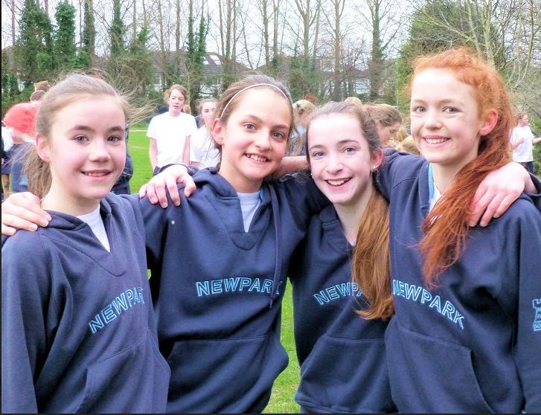
A Supporting and Caring Environment
The Student Support Team
Guidance Counsellors
Eoin Norton and Jenny Crampton
School Nurses
Nola Lambert & Avril Lahiffe
School Chaplain
Suzanne Harris
Resource Dept.
Emma Mullock

Slide 24

Creating a Positive Environment
Relationships and Behaviour Policy
Anti-Bullying Policy
Restorative Practice
Student Council

Slide 25
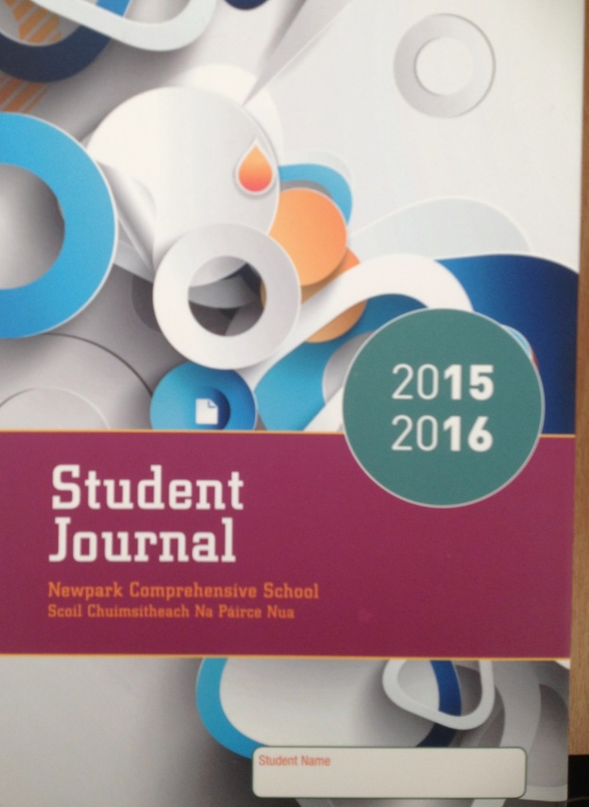
Communication with Home
School Journal
Texting System
Email
Reports
School App
Eportal
Communication from School office by
Email, Text and/or App

Slide 26

Co-curricular Activities
Young Scientist
Maths Week
Irish Club
Science Week
French Week
Seachtain na Gaeilge
Green Week
Music Links Programme

Slide 27
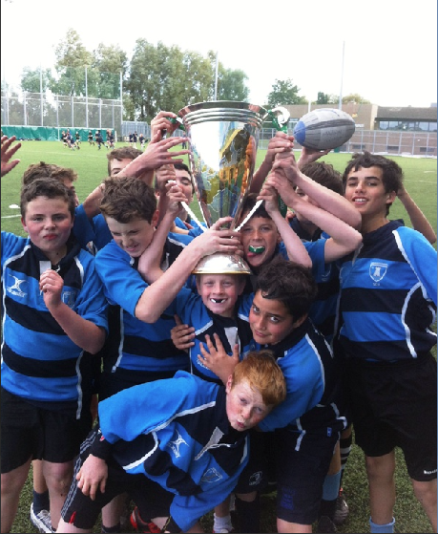
Extra-curricular Activities
Sport
Hockey
Rugby
Basketball
Swimming
Athletics
Tennis
Chess

Slide 28

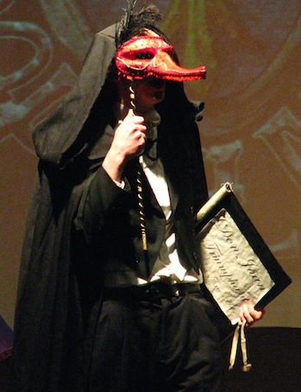
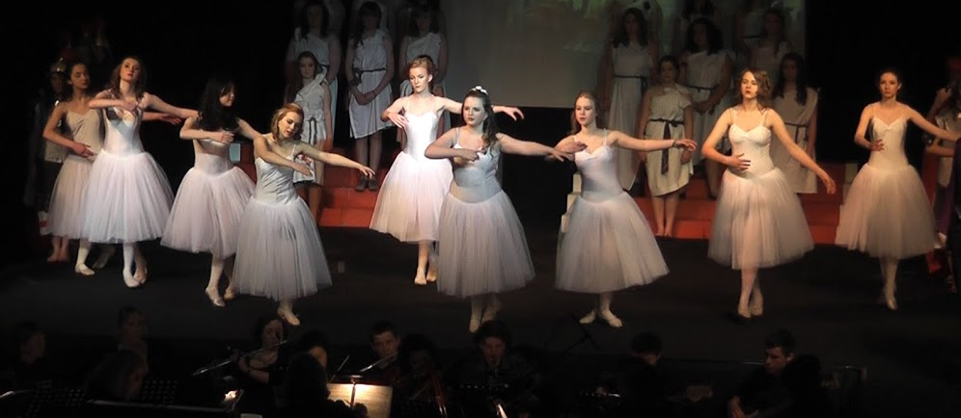
Extra-curricular Cultural
Activities
Drama, Musicals
Debate
M.U.N
In April 1st Years cooked dishes from around the world and shared them with
all students
Notes:
Drama: A view from the Bridge, The Crucible, A Midsummer Nights Dream’
Debate –Junior and Senior
Plus outside competitions in English and Irish

Slide 29
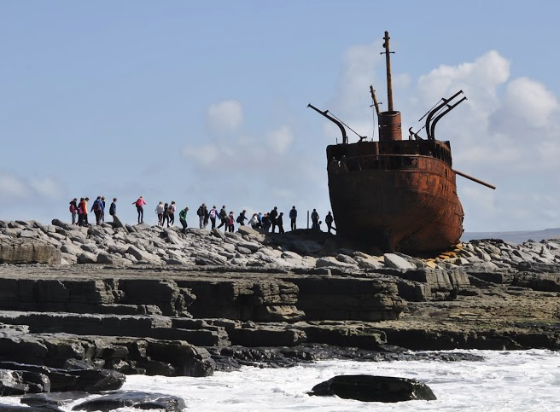
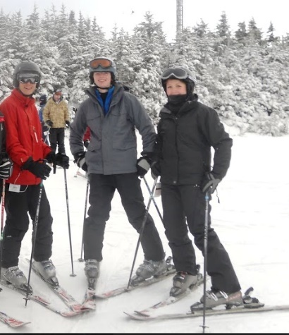
Extra Curricular Activities
Travel
Aran Islands
London
Stratford
Donegal
Paris
Berlin
Language Exchange

Slide 30

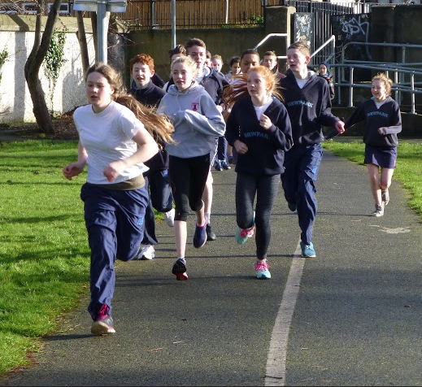
Voluntary Contribution
There is no charge for basic tuition
School Nurses
Equipment
Improvement Projects
Librarian
Books and prizes
Co-curricular sports

Slide 31
Estimate Cost
Books Approx €300
Uniform €120
Locker rental (PTA Six Years) €120
Voluntary Contribution Year 1 €325
ECA Sports €100

Slide 32
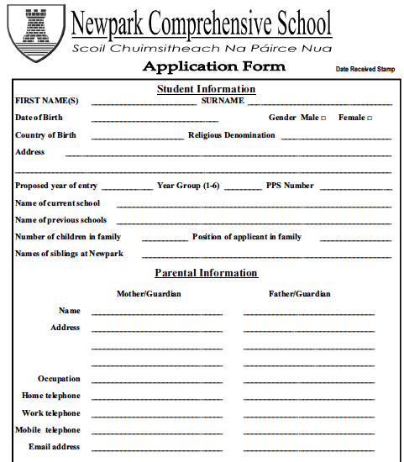
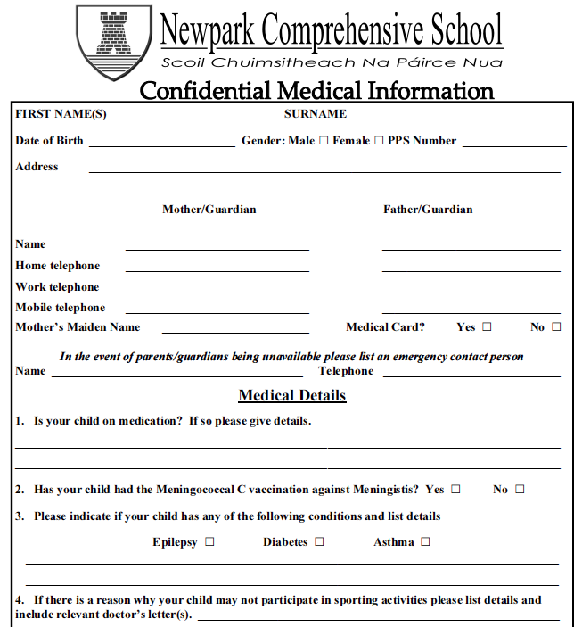

Complete Application Forms
AF1 – General
AF2 – Medical
AF3 - Academic
Full disclosure of
all relevant information
Notes:
Complete the Application Forms
AF1 – General Information
AF2 – Medical
AF3 - Academic Profile
Full disclosure of all relevant information
Applications will be dealt with in rotation, according to the date on which the original application was received in the school.

Slide 33
Submit an Application?
Deadline for acceptance
Friday, 24th November 2017
Places will be allocated week commencing Monday, 27th November 2017

Slide 34
Important Dates
Year One Induction: March/April 2018
Information evening: April 2018
First Day: Late August 2018
Parents’ meeting: September 2018
Report collection: December 2018

Slide 35

Address enquiries about enrolment to Ms. Rachel Plunkett
Postal Address: Newtownpark Avenue
Blackrock,
Co. Dublin
Communications
Telephone 01-2883724 (9.00 – 4.00)
Web Site www.newparkschool.ie
E-mail office@newparkschool.ie

