Slide 1
First Year Information Evening
Wednesday 20th March 2019
WELCOME!

Slide 2
Information Evening: Introductions
Derek Lowry Principal
Year Leader Siobhan Costello

Slide 3
Aims for First Year
Settle in and enjoy coming to school
Set good patterns of participation and achievement in classwork and homework in order to achieve potential
Participate in extra curricular activities
To enable each student to reach their potential over their 6 years in the school and follow the course of their choice
To enable each student to become an independent learner
To encourage critical thinking

Slide 4
To facilitate creativity
To promote well-being
To develop and maintain good practice and high standards in the content and presentation of work

Slide 5
Transition from Primary to Secondary – Key Issues
Numbers, building and people – Much bigger than in primary
Friends – making new, keeping old (significant issues from same school – contact year leader: siobhan.costello@newparkschool.ie by the end of April 2019.)
Curriculum – Still significant differences; pace of learning faster and broader
Active learning methodologies becoming common at 2nd Level

Slide 6
Transition – day to day
Less movement between rooms in Primary
Possibly more movement within the classroom
Finding their way around the school
Significant increase in the number of subjects studied
Previously interaction with one or two significant adults outside the family – now maybe a dozen different adults during the week

Slide 7
Transition - Peers
Changing from child to adolescent
Growing influence of peers
Who do they make friends with?
Coming to school and going home from school?
More freedom, less direct parental supervision
Talk to your child about their day
Advise making contact with other parents

Slide 8
Transition - organisation
Compared with primary much more personal responsibility for homework, books and equipment; “much more responsibility to remember stuff, like, remembering what homework to do and for when, and getting to your locker on time”
Proper use of journal and lockers will help
Put a copy of the timetable in a clear and visible spot at home; label books & clothes
Parental assistance vital; close supervision in first few months pays dividends
Contact form teacher if there are any issues.

Slide 9
Principal Derek Lowry
Student
Support Team
Guidance Counsellors, Nurses, Chaplain, Deputy Principal, SEN Coordinator
Deputy Principal Mark Cookman
Deputy Principal Andrew Adams
SEN
Key Workers
Year Leader
Siobhan Costello
Junior Cycle Coordinator Hugh Holmes
Form Teacher
Form Teacher
Form Teacher
Form Teacher
Form Teacher

Slide 10
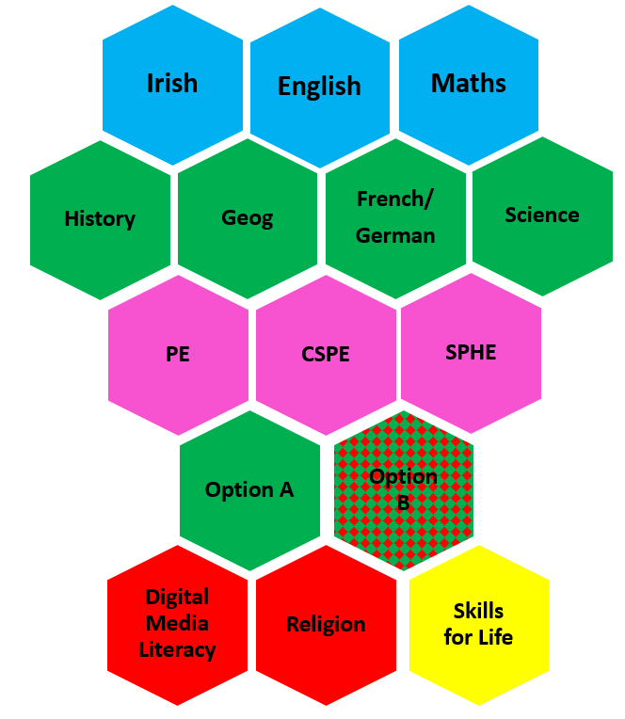

Current JC Programme in Newpark
for 1st Year cohort starting 2019

Slide 11
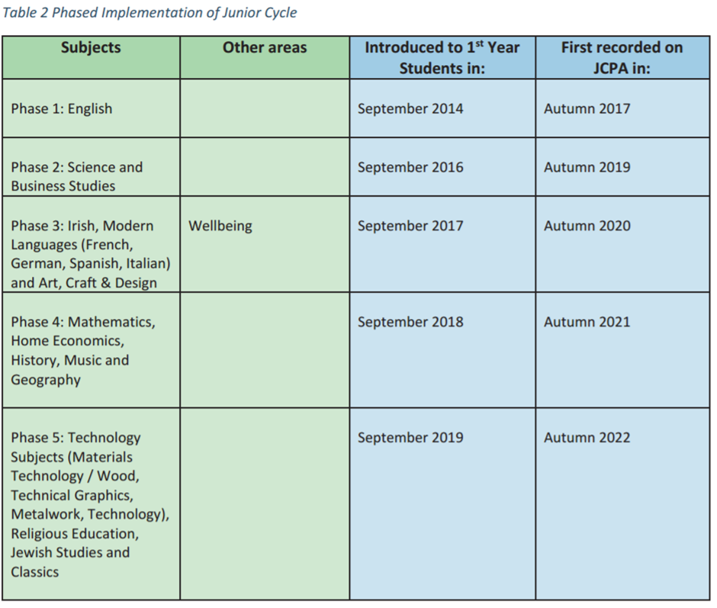

Slide 12
How will students be assessed?
CBAs
Assessment Task
10% of summative grade
Final Assessment
90% of summative grade

Slide 13
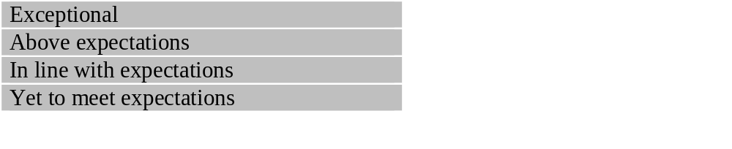
Classroom Based Assessments (CBAs) are used to assess students’ performances in both Subjects and Short Courses
The results are reported as follows:

Slide 14
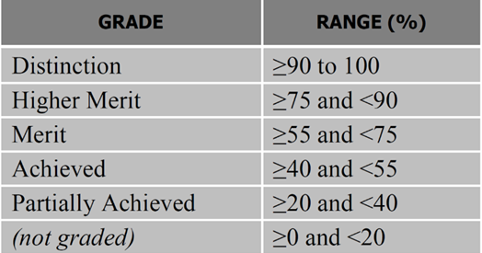
Summative Assessment of Subjects = Assessment Task (10%) + Final Assessment (90%).
The results are reported as follows:

Slide 15
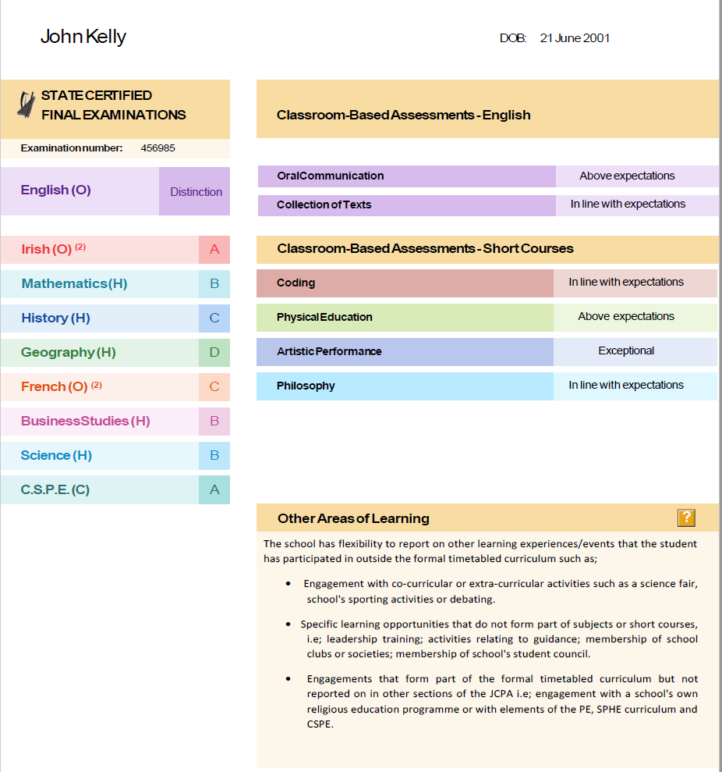

Slide 16
What do successful students do?
Participate in extra-curricular activities
Read, read, read
Limit screen time
Find a quiet place
Take ownership of their learning
Attend school on time

Slide 17
Languages
French
German
European Section

Slide 18
Special Educational Needs
Provide all relevant information
New Model of Allocation
More Flexibility

Slide 19
Child Safeguarding Policy and Anti-Bullying Policy
The Schools Child Safeguarding Policy is set up in line with the new DES Child Protection Guidelines
Anti-Bullying Policy – drawn up in line with DES Guidelines
Completed after consultation with staff, students and parents
Based on Restorative Practice methods

Slide 20
Attendance and punctuality
Vital
20+ Absences reported to National Educational Welfare Board
School starts at 8:45 each day
School finishes 15:50 except on Wednesday which is a half day and school finishes at 12:45 or 13:25 depending on the timetable
It is important that students come to school on time for their own benefit and also to avoid disturbing other students by late entrance to class

Slide 21
Extra Curricular Activities
Basketball for Boys and Girls
Hockey for Boys and Girls
Rugby
Drama
Music Links
Indoor Soccer
Christian Union
Chess
Debating

Slide 22
Parental Involvement
The Newpark PTA
The Board of Management
Voluntary Activity

Slide 23
Cancellations
Please inform us immediately

Slide 24
Starting Date
Tuesday 27th August 10.00am (Tbc)
Will receive timetable
Meet prefects
Have short assembly
Mid September – Meeting with parents/Guardians
Reports – Christmas 2019

